Slide 1
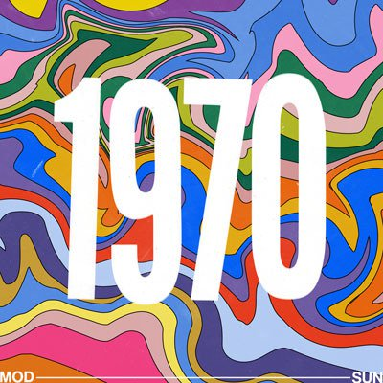

Slide 3
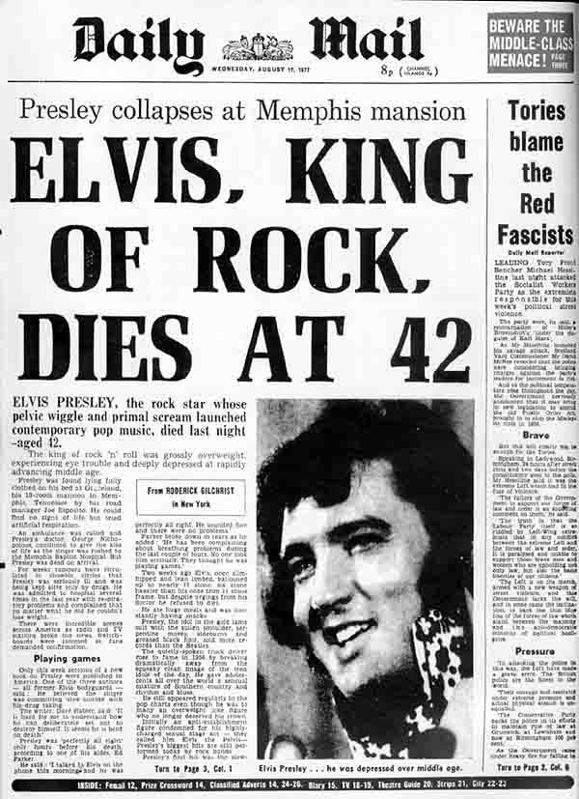

Slide 4
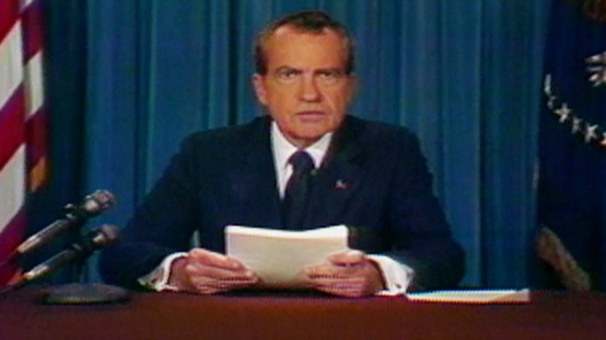
Video: https://time.com/3919625/richard-nixon-resignation/

Slide 5
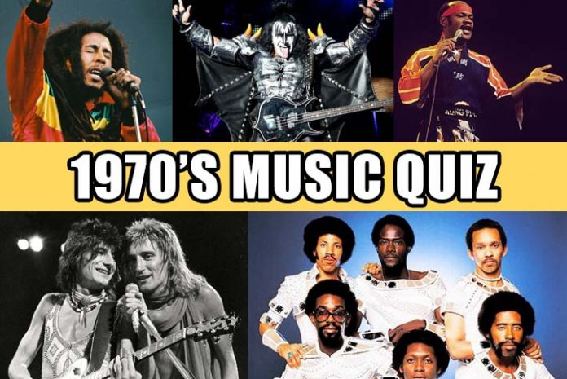

Slide 6
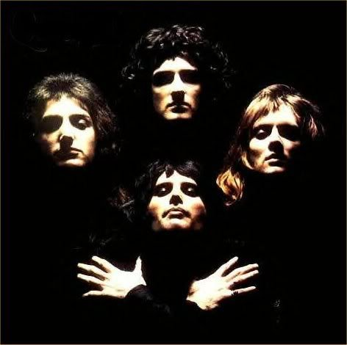
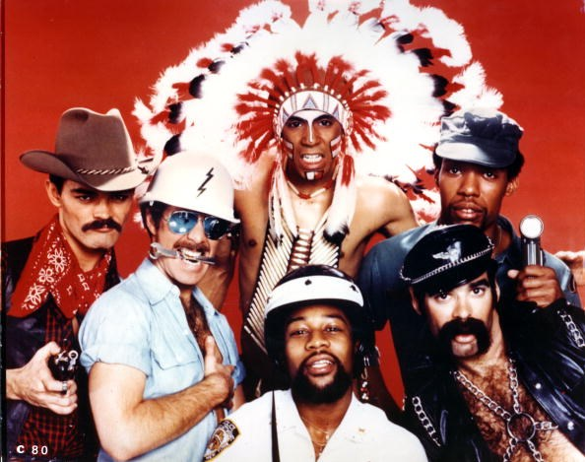
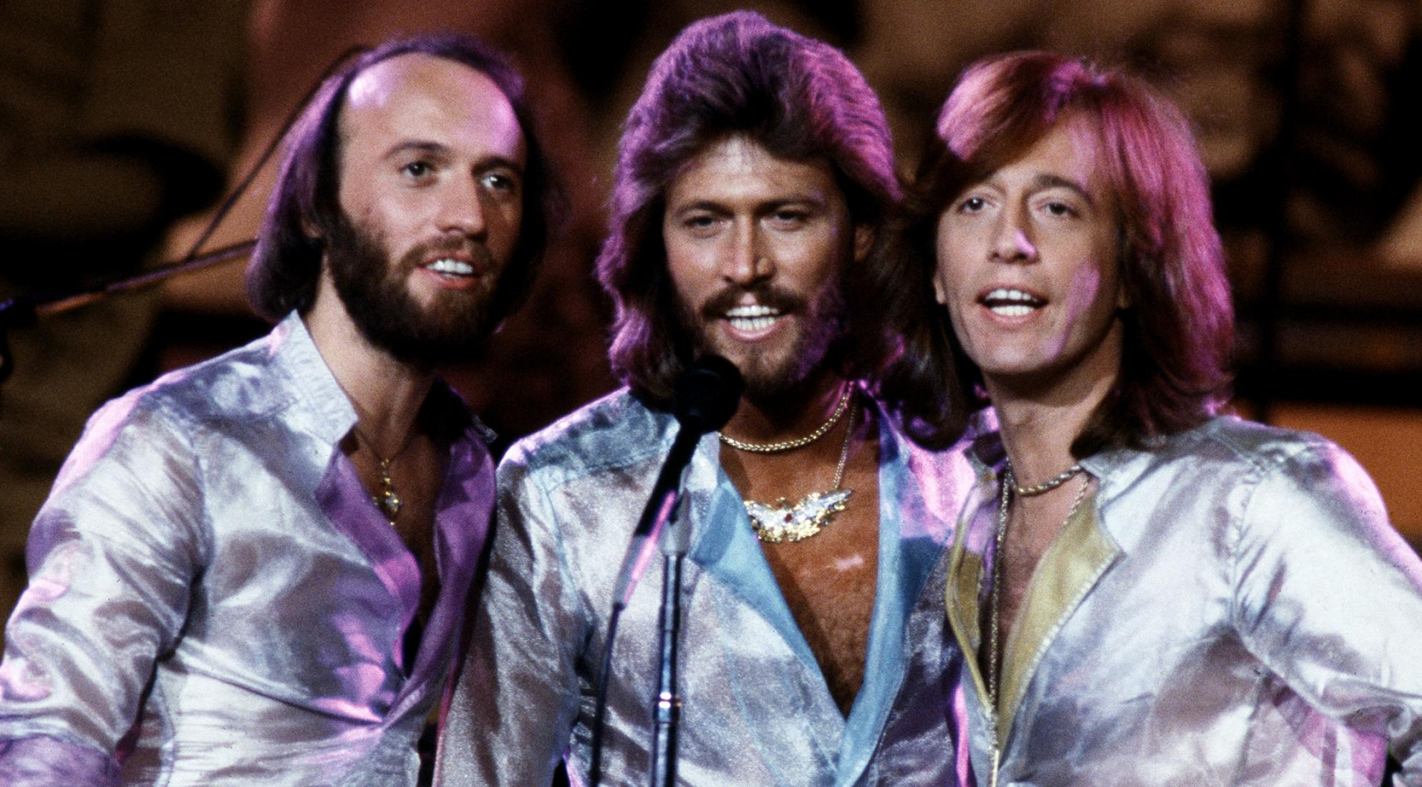
https://www.youtube.com/watch?v=I_izvAbhExY
Who sings this song?
Bee Gees
Queen
Village People

Slide 7
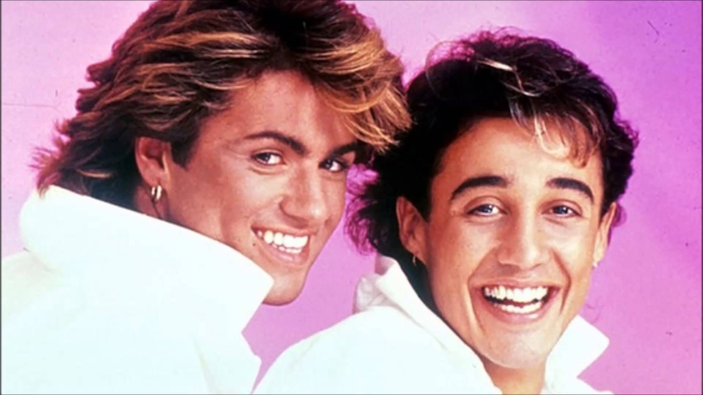
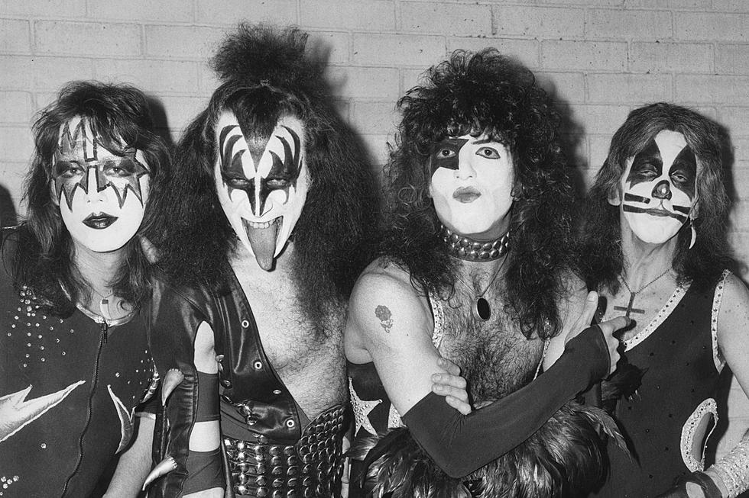
https://www.youtube.com/watch?v=PUoO4T_23pA
Who sings this song?
WHAM!
2. KISS
3. Village People

Slide 8
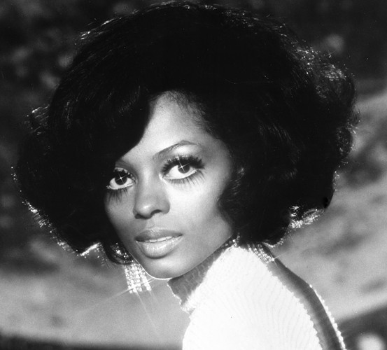
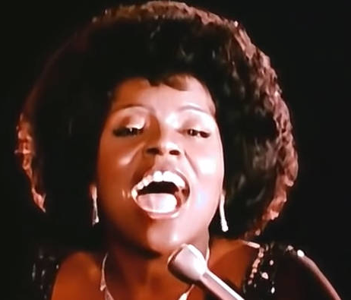
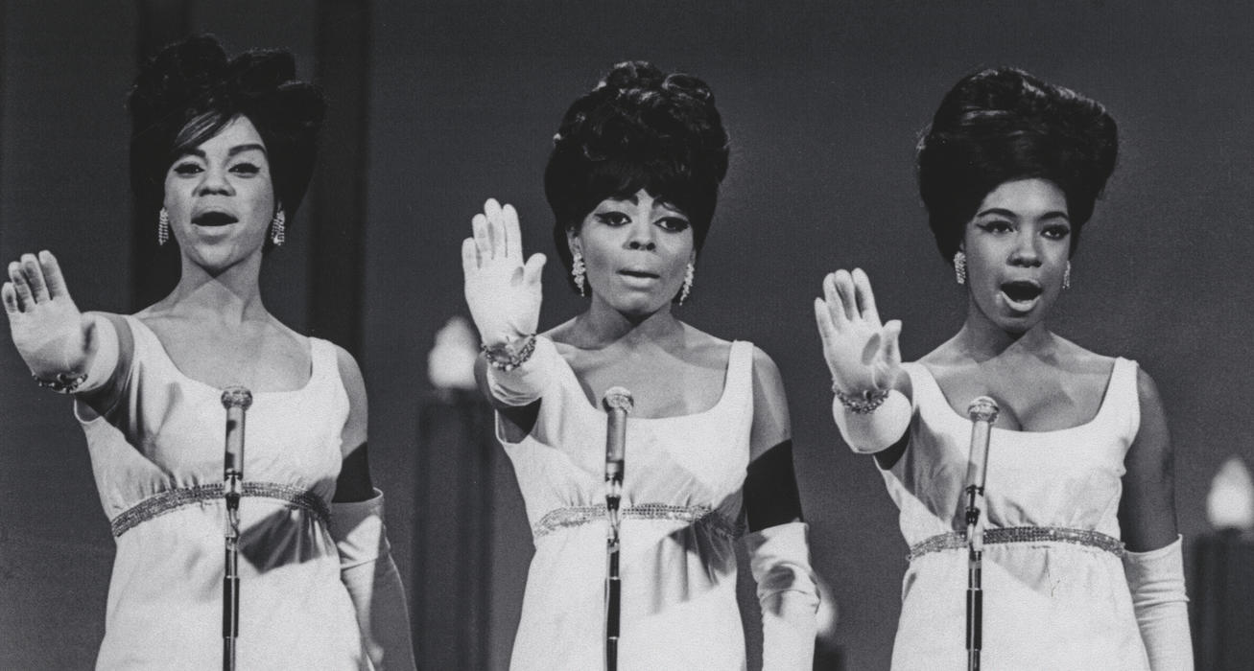
https://www.youtube.com/watch?v=ARt9HV9T0w8
Who sings this song?
Diana Ross
3. The Supremes
2. Gloria Gaynor

Slide 9
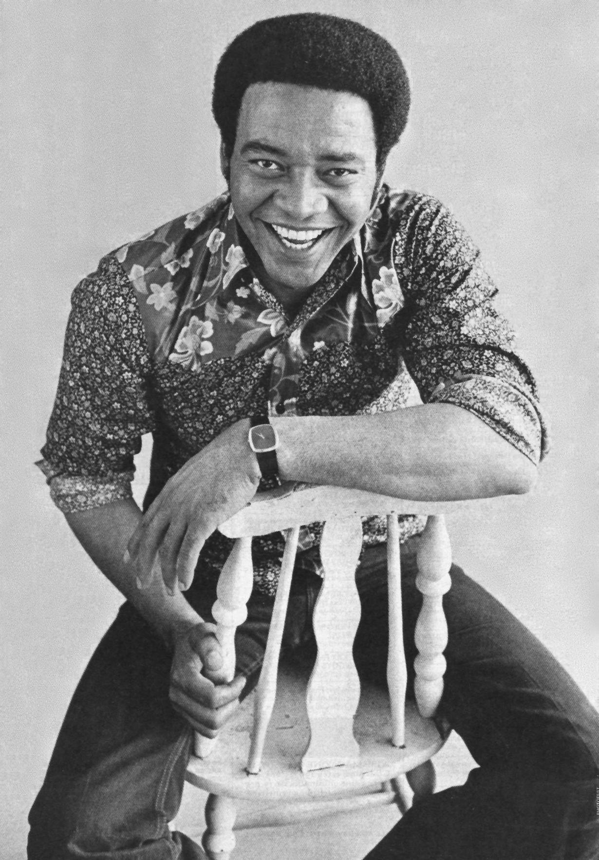
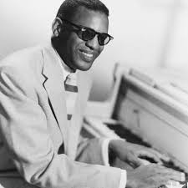
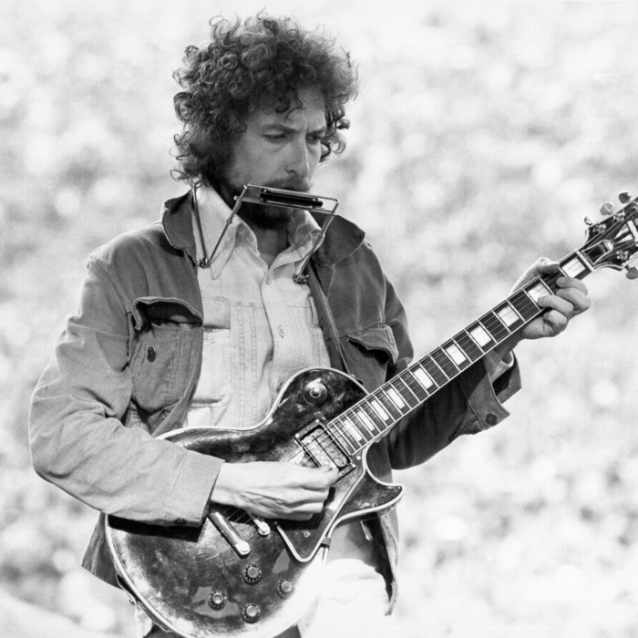
https://www.youtube.com/watch?v=qkaexjc-1os
Who sings this song?
Bill Withers
2. Ray Charles
3. Bob Dylan

Slide 11
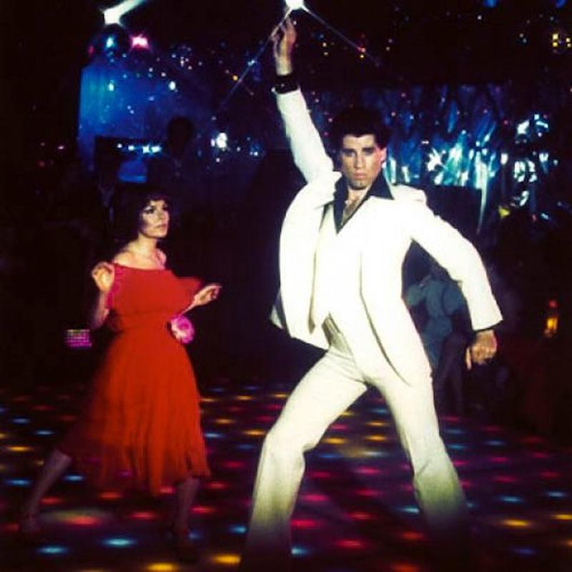

Slide 12
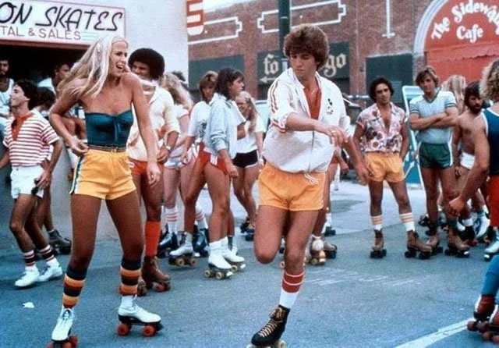

Slide 13
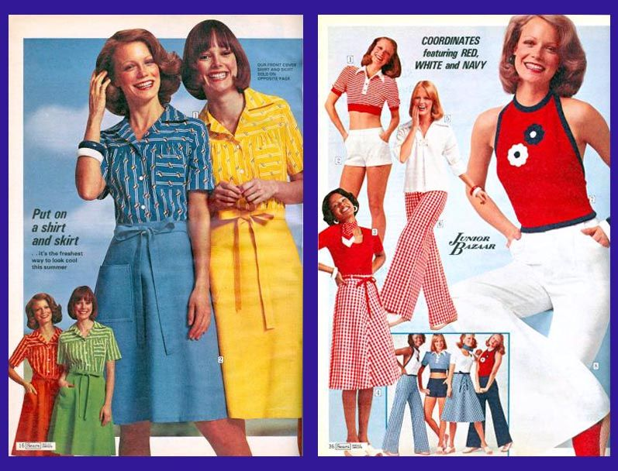

Slide 15
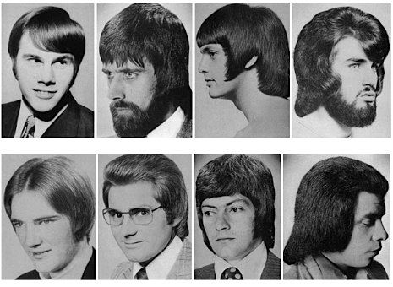

Slide 16
